Slide 1
CHILDHOOD ANEMIA
SOLOMON GELAYE
2019,JAN

Slide 2
Contents
  Hematopoiesis
  Definition of anemia
  Causes of anemia
  Classification of anemia
  Evaluation of the anemic patient
  Diagnostic approach to the anemic patient
  Management of Anemia

Slide 3
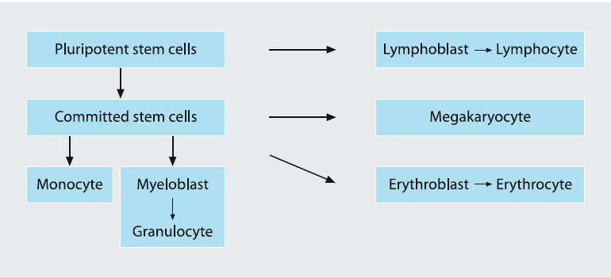
Differentiation during hematopoiesis

Slide 4
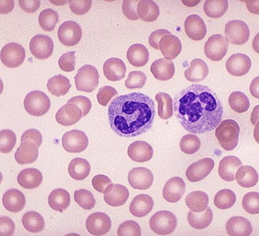
Normal Red Cells
No nucleus, enzyme packets
Biconcave discs – Haem + Gl
Center 1/3 pallor
Pink cytoplasm (HBOS filled)
Cell size 7- 8 µ - capill. 2 µ
EM pathway, HMP
Negative charge – no phago
Na less, K more inside
100-120 days life span

Slide 5
Definition of Anemia
Reduction in the Hb , Hct or RBC mass > 2 SD below the mean for normal population .
Hct: fractional volume of a whole blood sample occupied by RBCs.
Hb: a measure of the concentration of the RBC pigment hemoglobin in whole blood.
Normal ranges varies with age , sex & race. (blacks 0.5g/dl Hgb below than whites)

Slide 6
Anemia
Hematocrit (HCT ) is fractional volume of whole blood occupied by RBC
Hemoglobin is measure of concentration of RBC pigment hemoglobin(Hgb) in whole blood
The normal value for Hgb varies based on age and sex in pediatric patients
MCV = the volume of individual RBCs in the blood sample

Slide 7
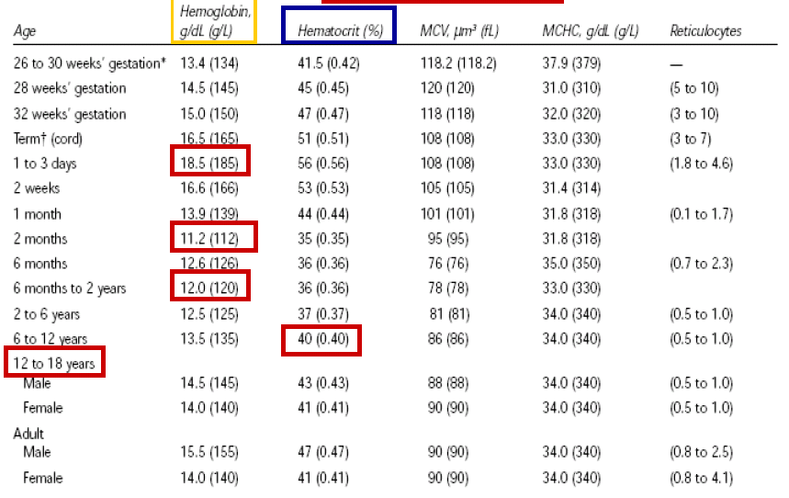

Slide 8
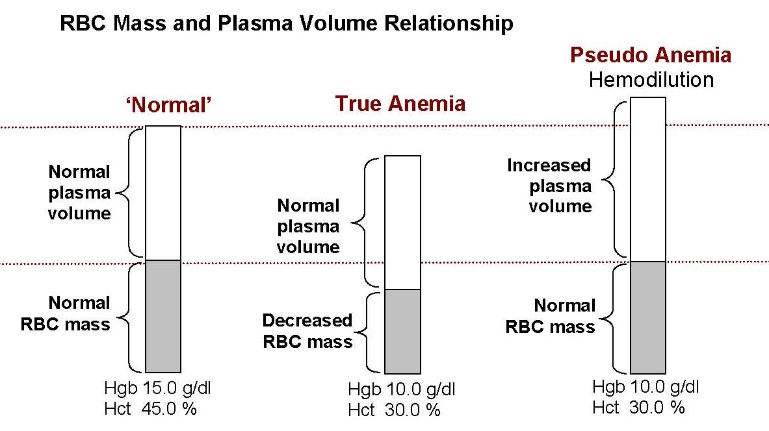
Definition of Anemia cont’d
Notes:
Discuss relationship of RBC mass and plasma volume in differentiating true from pseudo anemia.

Slide 9
Anemia
Anemia is a frequent laboratory abnormality in children.
30–50% of the global population has iron-deficiency
As many as 70% of children in developing countries will be anemic at some point by the age of 18 years.
In Ethiopia…DHS 2011
-6-59mon…44% anemic
-45%-Rural, 35% Urban
-mild 21%,moderate,20%,sever 3%

Slide 10
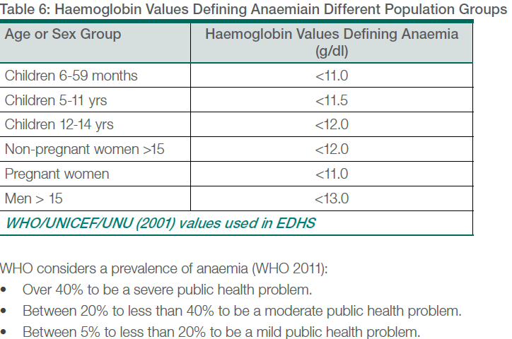

Slide 11
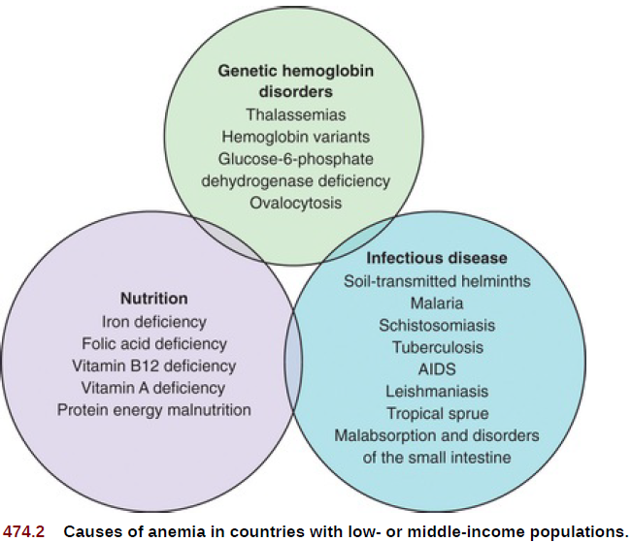

Slide 12
What happens in anemia?
O2 carrying capacity of the blood.
Few physiological disturbances occur until Hb < 8g/dL.
Pallor more evident when Hb < 8g/dL.
Pallor less obvious in dark skin .
Younger children less symptoms and signs.
Gradual drop in Hb cause less symptoms and signs.

Slide 13
Physiologic compensation for anaemia
  . Increase CO
  Increase O2 extraction
  Blood shunt to vital organs
  Increase 2,3-DPG within the RBC
  Increase EPO

Slide 14
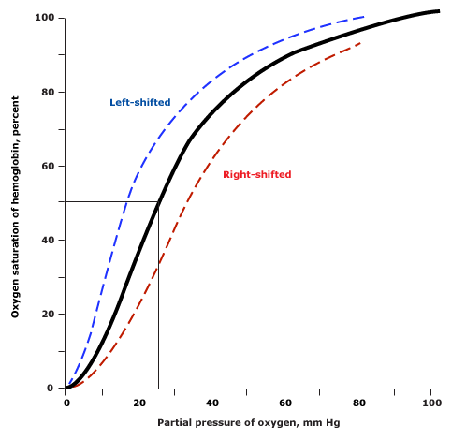

Slide 15
CLINICAL ASSESSMENT
WHO grading of anemia
Mild : Hgb 10-11gm/dl
Moderate: 7-10 gm/dl
Severe: less than 7gm/dl
Clinical grading
Mild: Conjuctival pallor/mucous membrane
Moderate: Obvious skin pallor
Severe: Palmer crease pallor

Slide 16
Symptoms & signs of anemia
Symptoms
-Lethargy & irritability
-Shortness of breath on exertion
-Dizziness
Signs
- Pale mucous membrane & palmar creases
- Tachycardia
-Cardiac failure (severe anemia)
- Other signs related to underlying disease process.

Slide 17
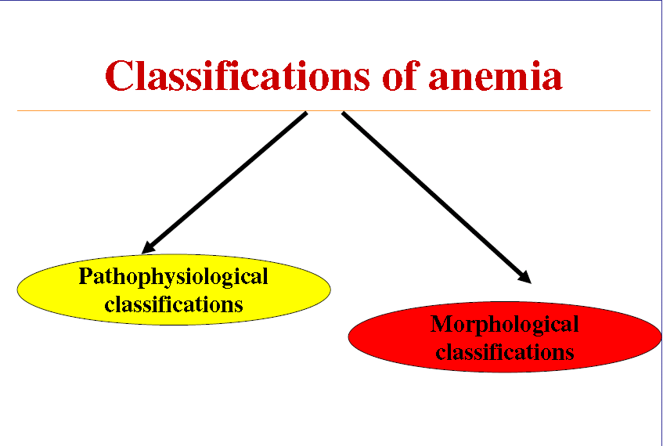

Slide 18
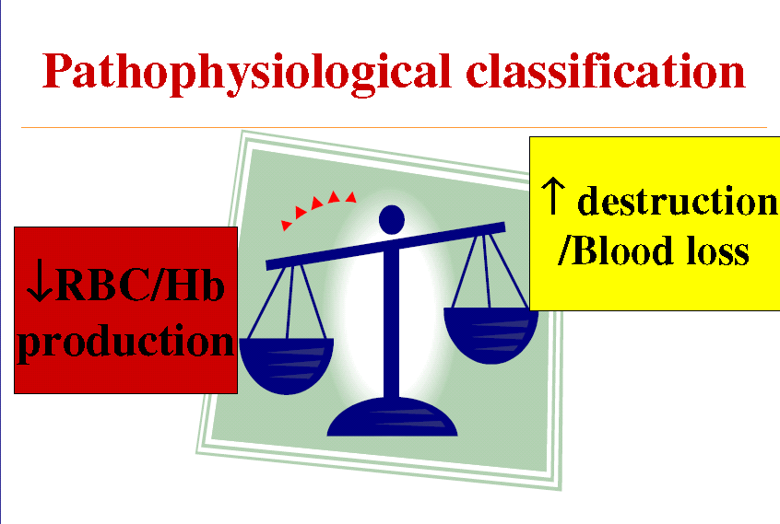

Slide 19
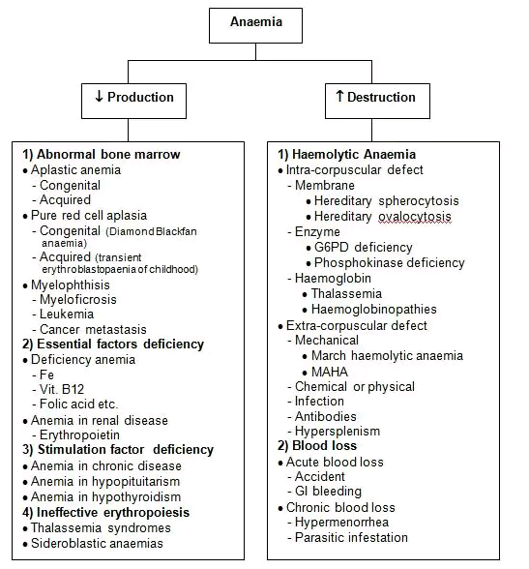

Slide 20
Morphological classification
Hemogram values
MCV <78fL
MCV 78-100fL
MCV>100fL

Slide 21
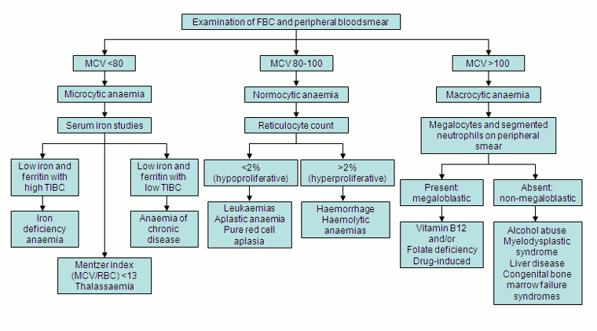

Slide 22
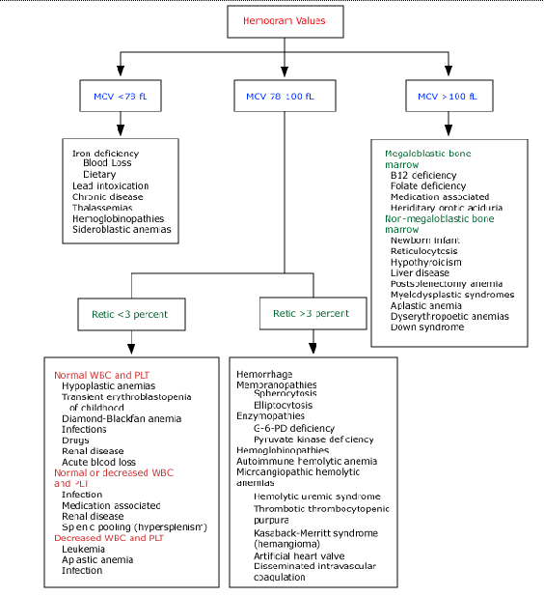

Slide 23
APPROACH TO CHILDHOOD ANEMIA

Slide 24
Diagnostic Approach
Important to remember
Anemia in a child is not a diagnosis, it’s a sign of underlying disease.
The goal is to determine the underlying cause of anemia.
Appropriate investigations of anemic child
should follow a detailed history & examination.
Correct interpretation of RBC parameters and CBC should direct supplementary tests.

Slide 25
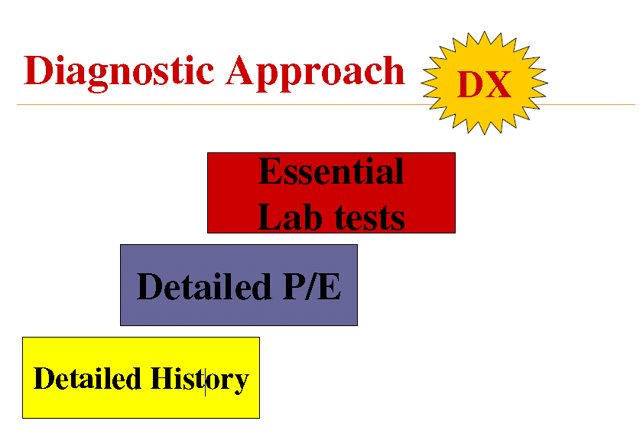

Slide 26
HISTORY
Age: Anemia cut point differ, age specific common problems like IDA common 9-24mon & adolescents, physiologic anemia of infancy.
Sex: G6PD deficiency in males (X –linked)
Race & Ethnicity: thalassemia in Mediterranean & S.E Asian decents.
-Hemoglobin S & C in blacks & Hispanic population
Severity & initiation of symptoms:
Chronic anemia are asymptomatic b/c of body compensatory ability. Acute anemia - more symptomatic.

Slide 27
HISTORY con…
Hemolytic episodes:
Prior hx of anemia-duration , cause & Rx.n
History of repeated blood transfusions
  Blood loss hx: gastrointestinal tract, including changes in stool color, the identification of blood in stools, and history of bowel symptoms
  Teenagers have excessive menstrual losses ,menstrual history including duration of periods, flow, quantitation and saturation of tampons or pads, should be obtained

Slide 28

Hx con…
Underlying medical & surgical conditions …
Diarrhoea:
  Malabsorption of VitB12/Fe.
  Intestinal resection: Vit B12 def
  Giardia: iron malabsorption
  Intestinal bacterial overgrowth: VitB12 def
  EBV,CMV,Parvovirus: BM suppression
  Mycoplasma,Malaria:hemolysis
  Intestinal resection -vit B12def
  Drugs or Toxin exposure ….
  .(1)G6PD:oxidants(sulfa, primaquine, henna) (2)Immune mediated hemolysis (penicillin) (3)Bone marrow suppression (chemotherapy)
  (4)Phenytoin increase folate requirement
  specific questions regarding environment, housing, paint exposure, cooking materials, and use of poorly glazed ceramic pots in order to evaluate for possible lead exposure
  Nutritional hx …
  . (1)Cows milk diet:iron def.
  (2)Strict vegetarian:Vit B12
  (3)Goatsmilk:Folate def.
  Starvation and generalized malnutrition

Slide 29
Hx con…
Birth hx ….
A birth and neonatal history including infant and mother's blood type,
Gestational age at birth.
The presence of jaundice or need for phototherapy
Developmental hx .
Loss of milestones or developmental delay in infants with megaloblastic anemia
Family hx …
(1)X-linked: G6PD def
(2)Aut dominant: Spherocytosis
(3)Aut recessive: Sickle cell,Fanconi anemia
(4)Family member with early age of cholecystectomy/splenectomy
(5)Ethnicity: Thalassemia; G6PD def

Slide 30
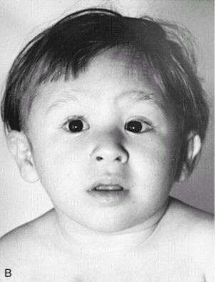
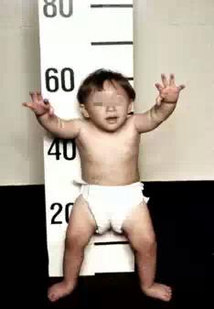
PHYSICAL EXAMINATION
General appearance

Slide 31
P/E con…
Vital sign
-Fever= acute infection, collagen vascular
-HTN=renal
-Tachycardia/Tachypnea= degree of anemia
A/M
-Stunted = fanconi , malnutrition
-microcephally = fanconi
-Growth failure or poor wt. gain—Anemia of chronic disease or organ failure
Short stature-Fanconi anemia, Malnutrition

Slide 32

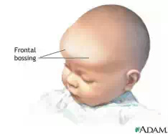
P/E con…
HEENT
-Head-- Frontal bossing, prominence malar = =thalassemia, congental hemolytic anemia

Slide 33
P/E con…
-Eyes --Microphthalmia= fanconi
--Cataracts; G6PD def, galactosemia with hemolytic anemia
--Blue sclera; IDA, collagen vascular disease
--Jaundice; hemolysis , hepatitis
--Edema of eyelids; infectious mononucleosis, renal failure

Slide 34
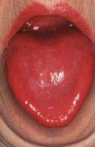
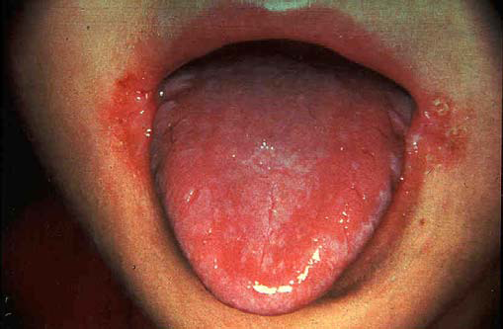
P/E con…
-Ears----
-Mouth —Glossitis= vit B12,IDA
--Angular stomatitis=IDA

Slide 35
P/E con…
LGS
-LAP-infiltrative diseases
CHEST
-Shield chest = Diamond black syn.
CVS
-Endocarditis , prosthetic valve= cause hemolysis

Slide 36
P/E con…
ABDOMEN
-HSM--infiltrative tumour , hemolysis
-Splenomegally-- -hemolysis,sickle cell disease,thalassemia,malaria,EBvirus, portal hypertension
IS
-Skin--Hyperpigmentation,café au lait spots- Fanconi anemia
-Petechiae , Purpura ----- BM infiltration, autoimmune hemolysis & thrombocytopenia .
-Jaundice---- hemolysis
-Erythematous rash-- Parvovirus,EBvirus
-Cavernous hemangioma-- MAHA
-Malar rash-- SLE;
-Spoon nails--IDA

Slide 37
P/E con…
MSS
-Hands -triphalangeal thumbs=DBA
-absent thumb = Fanconi
-hypoplasia of thenar eminence

Slide 38
P/E con…
CNS
-Irritable, apathy=IDA
- Blindness= Osteopetrosis
- Deafness= Osteopetrosis
-Ataxia, post. Column sign.. Vit.B12 def
-Peripheral neuropathy= lead poisoning
-Stroke = sickle cell anemia

Slide 39
Evaluation of the anemic child
The first step
Make sure a child is truly anemic
The second step
Developing a differential diagnosis
  History, physical examination, CBC and the peripheral blood smear (PBS)

Slide 40
Evaluation of the anemic child
Step 1 : Determine the child is anemic using the Hb/Hct
Step 2: Evaluate the Red Cell Indices
Step 3. Assess the white blood cell (WBC) and platelet counts
Simple anemia Vs pancytopenia
Elevated WBC and/or platelet count
  most often due to reactive processes
    infection is the most common cause
    iron deficiency anemia
    autoimmune disorders
    inflammatory bowel diseases
    hemolytic anemia
    vitamin E deficiency

Slide 41
LABORATORY EVALUATION
A sample of adequate volume should be obtained.
The most important test is CBC.
1. RBC indices.
2. Reticulocyte count.
3. Blood smear.
4. Other CBC parameters

Slide 42
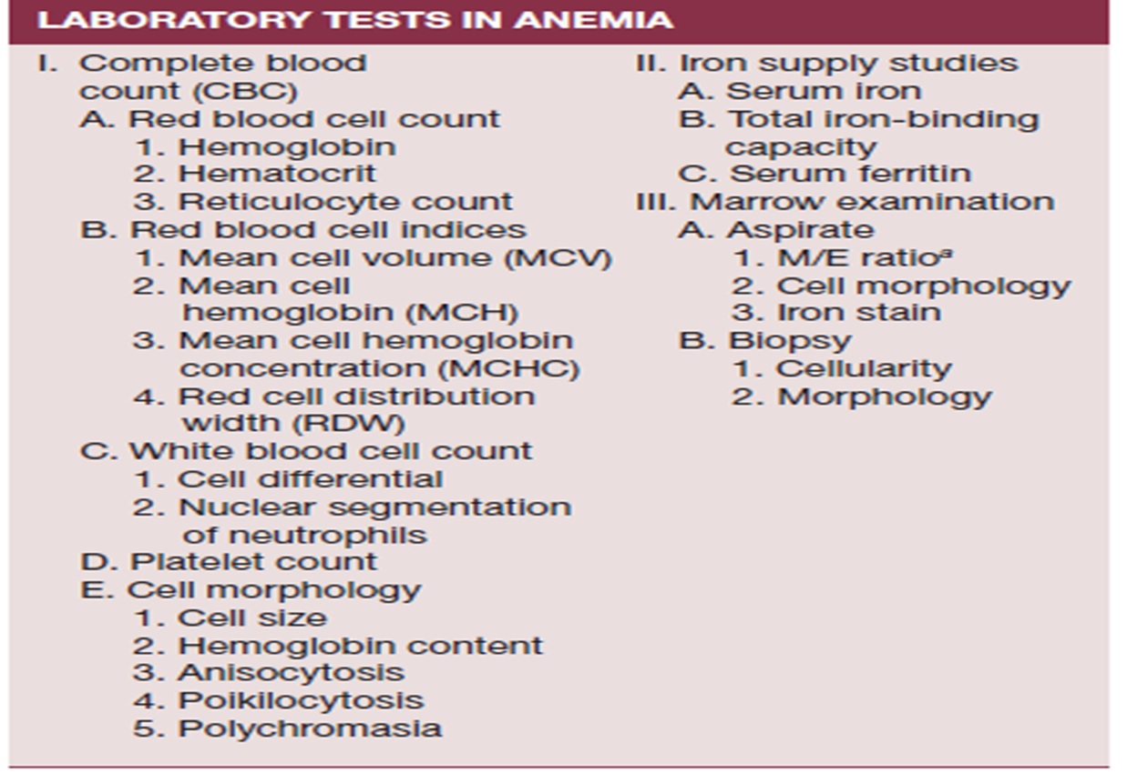
LABORATORY EVALUATION

Slide 43
RBC Indices
Mean corpuscular volume (MCV)
-Represent the mean value of RBCs size in the blood sample.
-Normal value vary based up on age.
- MCV= Hct x 1000 / RBC (cells x 10-12/L) (FL)
  -MCV value with in 2SD considered normocitic. Infants have high valu.
  -It increase with decrease gestational age.

Slide 44
MCV
  The lower limit for the MCV(<10 years) approximately 70 fL + age in years
  The upper limit fo(>0.5 years) is 84 + 0.6 fL per year until the upper limit of 96 fL
  Enables classification of anemia
    microcytic
    normocytic or
    macrocytic.

Slide 45
MCHC
Measure of cellular dehydration
MCHC = Hb (g/dl) / Hct
gm of Hb per 100 ml RBC
Values vary based on age.
Normal value 33-34gm/dl (normochromic)
High value > 35 is characteristic of
Spherocytosis , hemolytic anemia.
Low value is most commonly seen in IDA

Slide 46
Reticulocyte count
Reticulocytes ;
are the youngest red cells in the circulation, and are identified via the presence of residual RNA, which gives them a blue tint on standard Wright-Giemsa stains.
Reported as percentage of RBC population
-Normal value -1%
-Newborns -2-6%

Slide 47
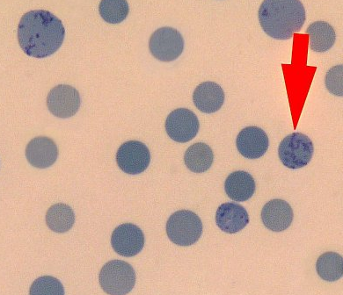
Reticulocyte
No definite nucleus
Reticulum of RNA
Deep blue staining
Light blue cytoplasm
Cell size about 10 µ

Slide 48
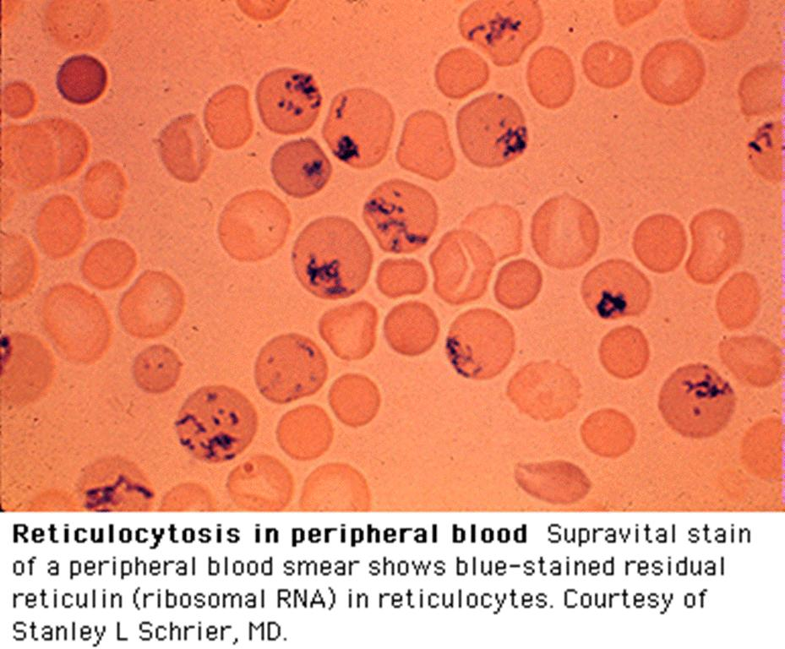

Slide 49
Reticulocyte count
Normal range depend on Hgb level , higher when low hgb.
To distinguish impaired erythropoiesis from increased erythrocyte destruction.
Because the Retic reported as % of total RBCs, pts with moderate to severe anemia may have an elevated Retic count that is inadequate.

Slide 50

Reticulocyte count
It must be corrected for the reduction in red cell count to accurately reflect erythrocyte production. This correction is made by calculating reticulocyte index:

Slide 51
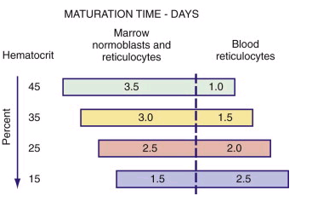
Reticulocyte index

Slide 52
Reticulocyte index
RPI indicates whether bone marrow is responding appropriately to anemia
The normal reticulocyte index is 1.0; therefore, the index measures the fold increase in erythropoiesis.
Elevated Ret. Index (>3%)-suggest active erythropoiesis in response to hemolysis, bleeding, replacement rx ( iron), recovery from TEC
Low Ret. Index (<3%)-suboptimal BM response (aplasia, malignancy, infection , toxic agent…)

Slide 53
Red cell distribution width(RDW)
Is a quantitative measure of the variability of RBC size in the same sample
= Standard deviation of MCV X 100 / MCV
Normal value 12-14%
Useful to diff IDA from thalassemia
High value –IDA , normal in thalassemia
Sensitive indicator of RBC size changes before the RBC indices affected.

Slide 54
Variations in RBC Size & Shape
Anisocytosis -Variations in size (e.g.microcytes)
Poikilocytosis -Variations in shape (e.g.target cells)
Hypochromia -Increased central pallor due to decrease in hemoglobin.
Notes:
2

Slide 55
Peripheral smear
Blood film is very helpful in studying the size, shape and intensity of staining of RBC.
Interpretation of these changes will indicate the most likely DDx.
a) RBC size
- normal RBC has the same diameter as the nucleus of small lymphocyte
-microcytosis/macrocytosis

Slide 56
Central pallor
Normal RBC is biconcave, thin in the center resulting pallor.
Increased central pallor –IDA/thalassemia
Small, dark dense hyperchromatic ,no central pallor RBC=spherocytes

Slide 57
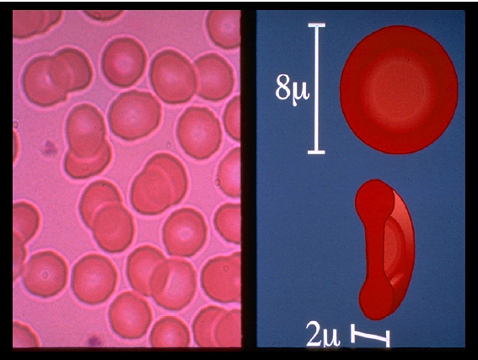
Red Cell Size

Slide 58
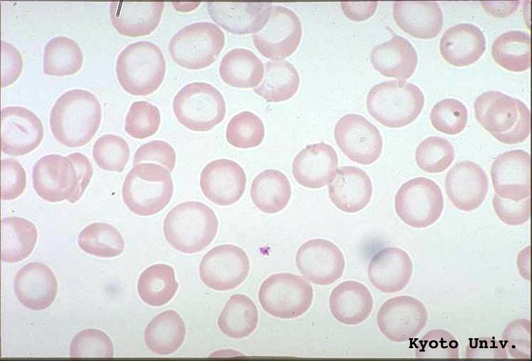
Severe Hypochromia

Slide 59
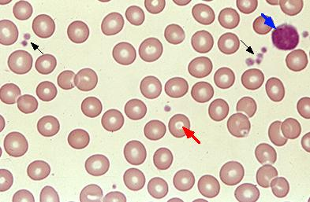
Normal peripheral smear

Slide 60
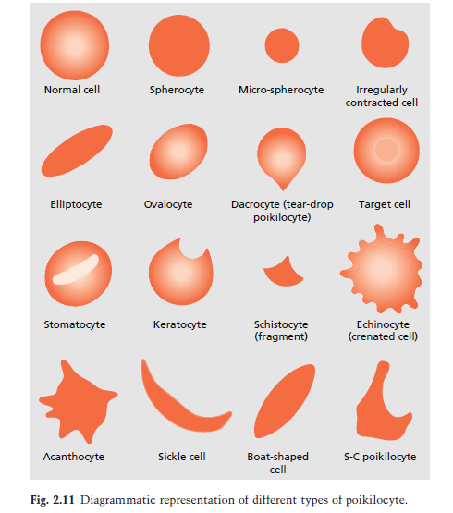
PERIPHERAL MORPHOLOGY

Slide 61
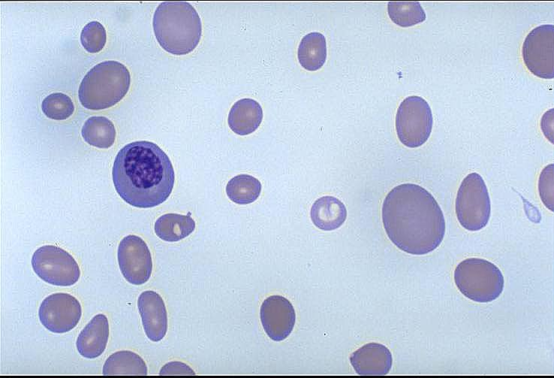
Anisocytosis - Macrocytic Anemia

Slide 62
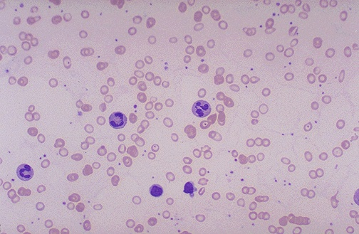
Microcytic Hypochromic - IDA

Slide 63
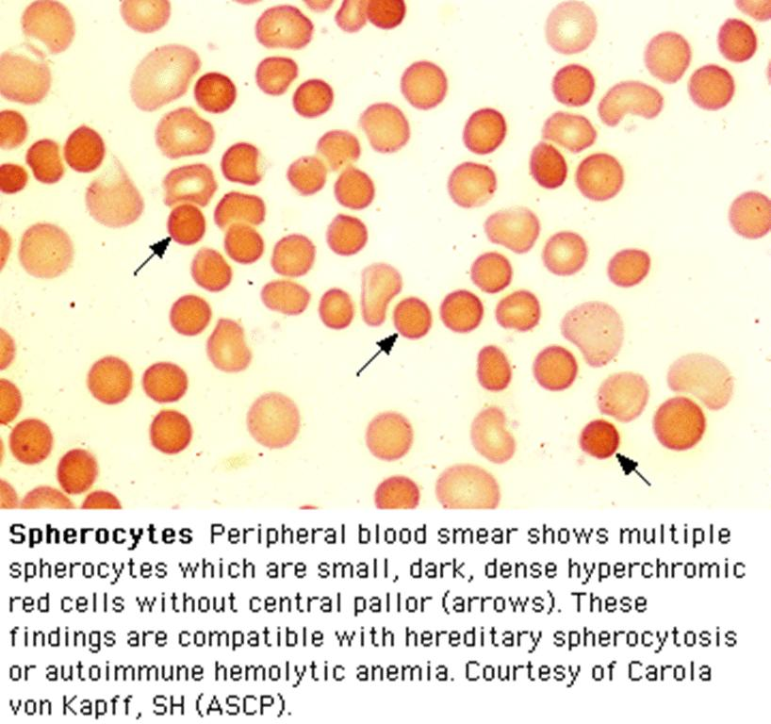

Slide 64
Peripheral smear con..
C) Fragmented cells- MAHA
d) Other features
.Sickle cells-
.Elliptocytes-
.Target cells-
.Blast –leukemia/lymph
.Neutrophilia, atypical lymphocytes-
-infection/inflamatory

Slide 65
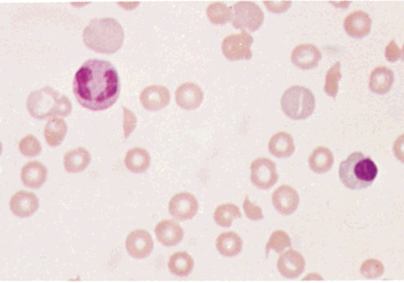
Shistocytes
Fragmented, Helmet or triangle shaped RBC
MAHA
Prosthetic valves
Uremia
Malignant HT

Slide 66
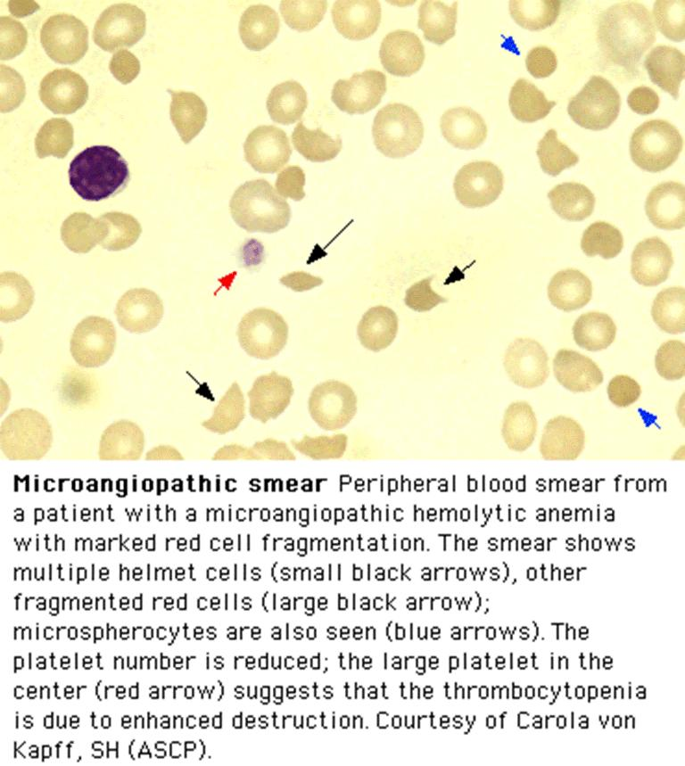

Slide 67
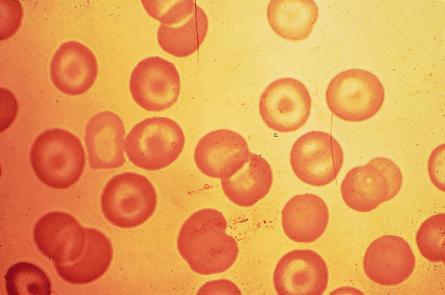
Target Cells
Diagnostic possibilities
  Liver disease
  Hemoglobinopathy
  Thalassemia
  Post-splenectomy
  Lipid disorders

Slide 68
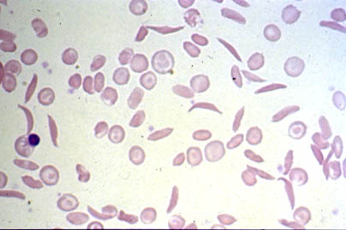
Sickle Cell Anemia: Hgb SS

Slide 69
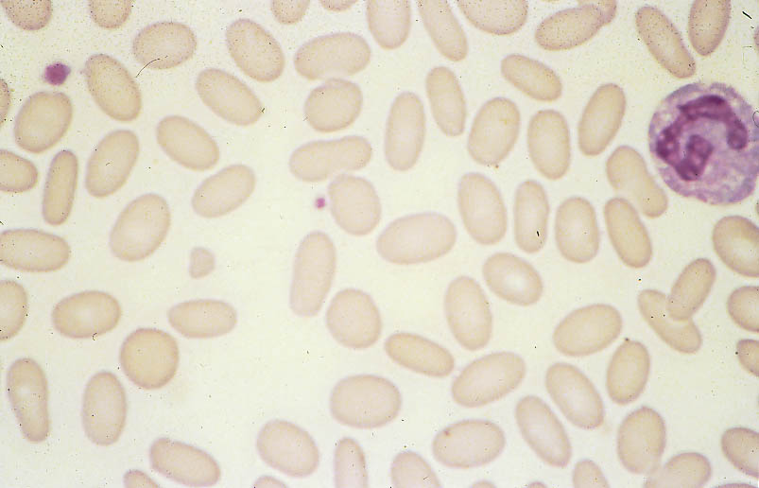
Elliptocytes: Hereditary Elliptocytosis

Slide 70
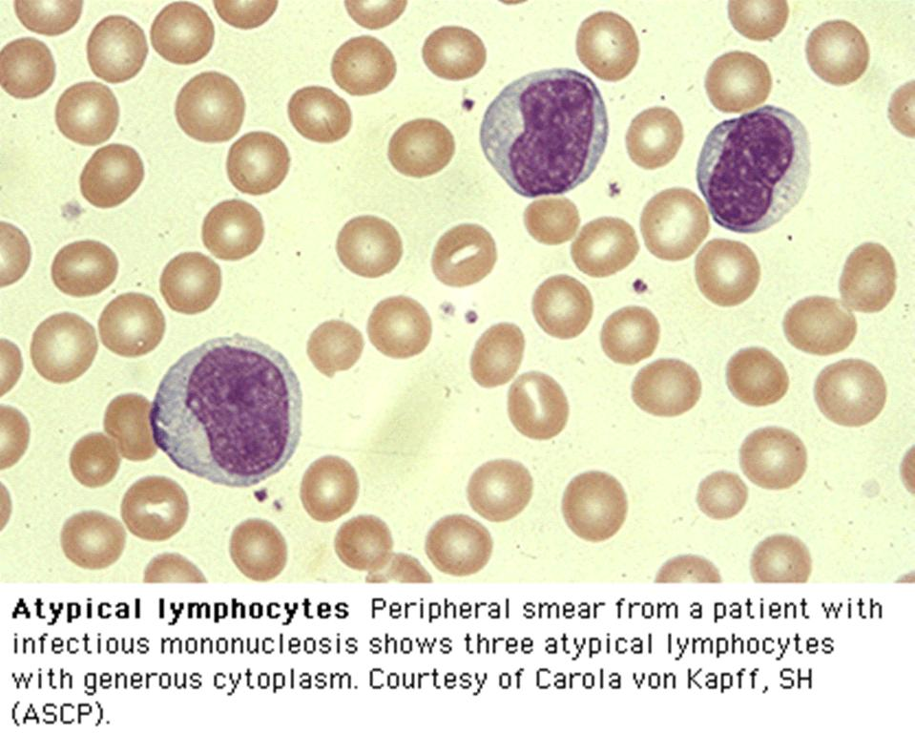

Slide 71
Other CBC elements
- RBC count
In case of Microcytic Hypochromic anemia:
1. Low RBC count indicate a lack of
production of RBC as in IDA
2. Normal/raised RBC count as in thalassemia

Slide 72
WBC and Platelet
Anemia is isolated finding or associated with other abnormalities.
High WBC & platelet and later anemia can be seen in =Infection & Inflamation
High platelet & anemia can be seen in patients with= hemolysis /IDA
Low platelet with anemia seen in patients with =HUS/Evans syndrome.
Pancytopenia is seen in- BMF, Leukemia

Slide 73
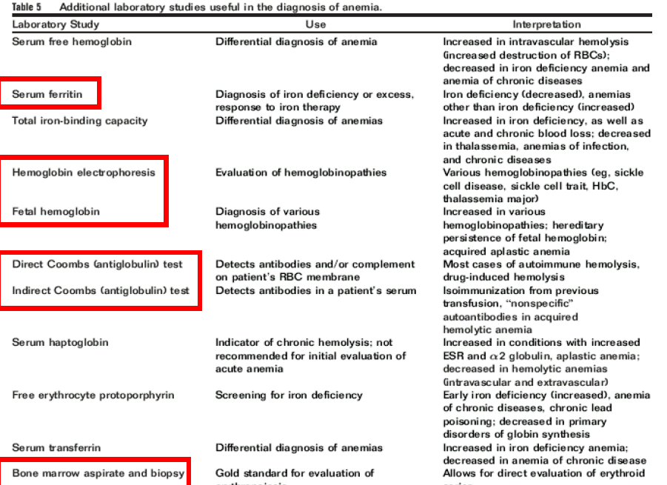

Slide 74
Other lab
Bilirubin level
Direct antiglobulin or Coombs test
Hemoglobin electrophoresis
Red cell enzyme studies
Osmotic fragility (spherocytosis)
Iron, TIBC, ferritin
Folate, vitamin B-12 (macrocytic)
Bone marrow aspiration and biopsy
Viral titers (e.g. Epstein-Barr virus, cytomegalovirus)
BUN/ creatinine
TFT,LDH

Slide 75
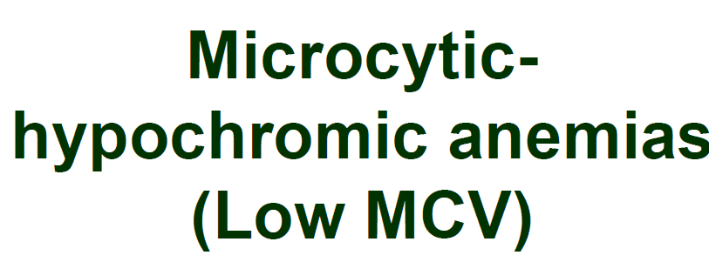

Slide 76
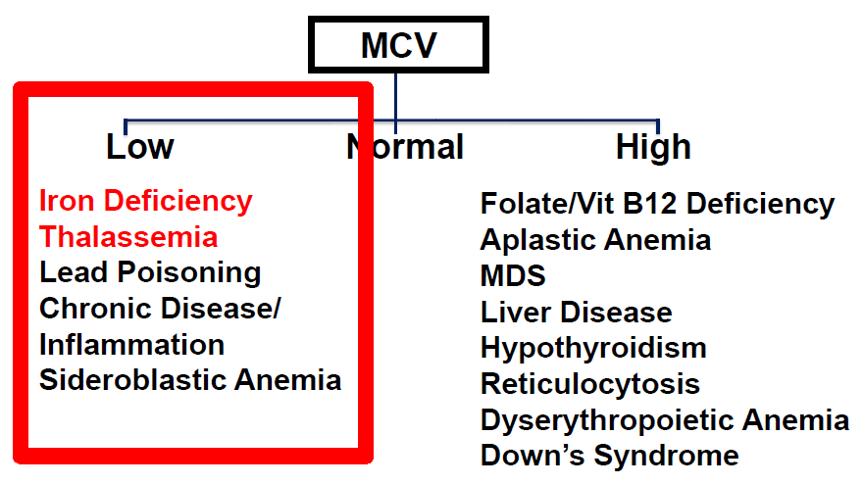

Slide 77
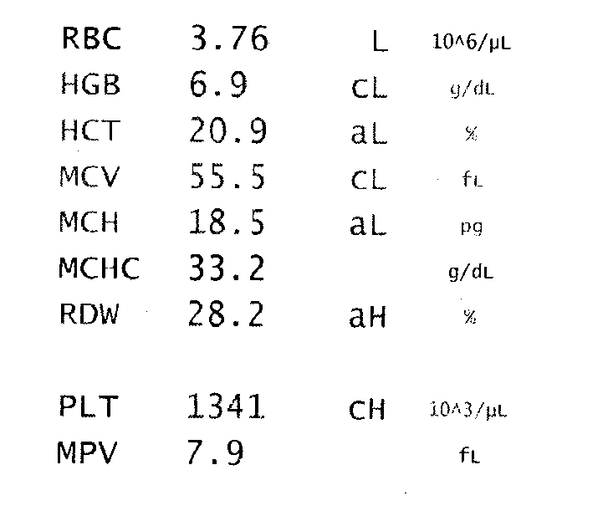
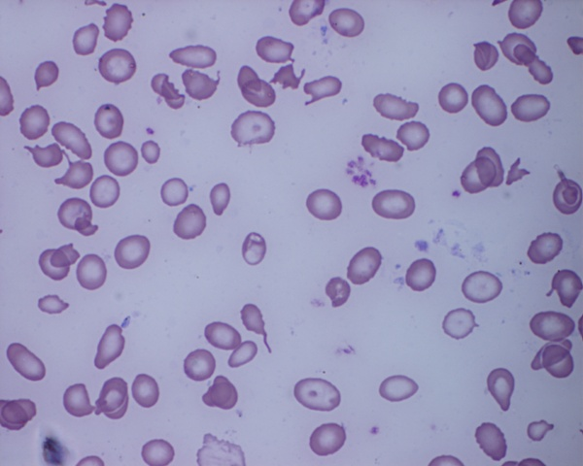
Microcytic hypochromic anemia
High RDW
Low RBC Count
Thrombocytosis
Serum ferritin-2 µg/ml
DIAGNOSIS??

Slide 78


Slide 79
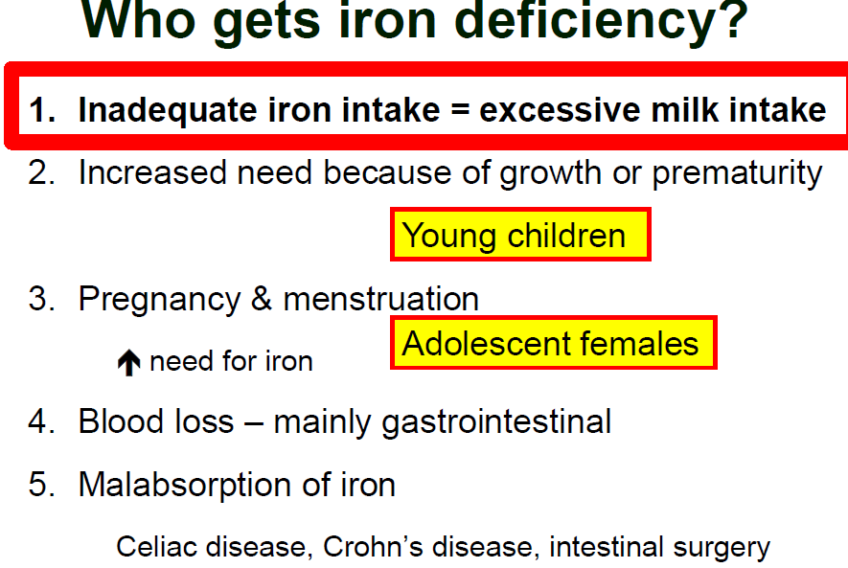

Slide 80
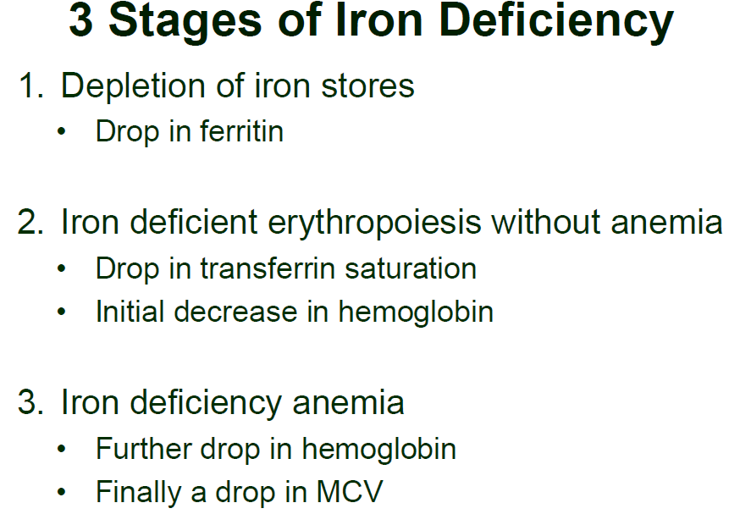

Slide 81
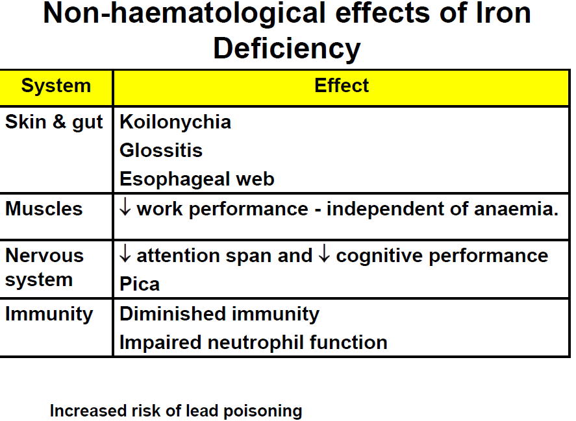

Slide 82
Typical peripheral blood values in patients with IDA
TEST | MILD IDA | MODERATE IDA | SEVERE IDA
Hemoglobulin | >11 g/dL Or in normal range | < 10 g.dL | < 10 g/dL
Hematrocrit | >36% Or in normal range | < 30 % | < 30%
RBC count | May be within normal range | May be within normal range | Decreased
MCV | May be within normal range | Microcytic; < 80 fL | Microcytic; < 80 fL
MCH | May be within normal range | < 27 pg | < 27 pg
MCHC | May be within normal range | Normochromic to hypochromic | Hypochromic
RDW | Slightly elevated | Frankly elevated | Frankly elevated
Reticulocyte Count | elevated | Elevated | elevated

Slide 83
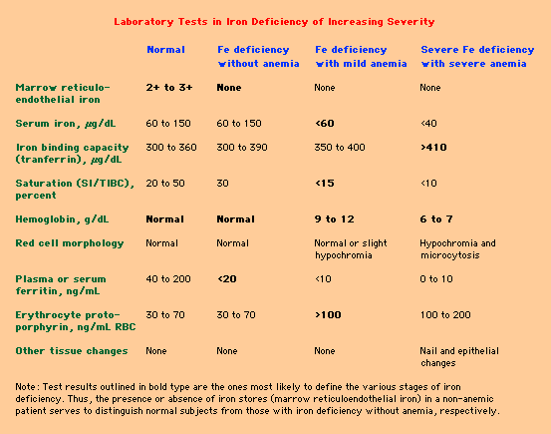

Slide 84
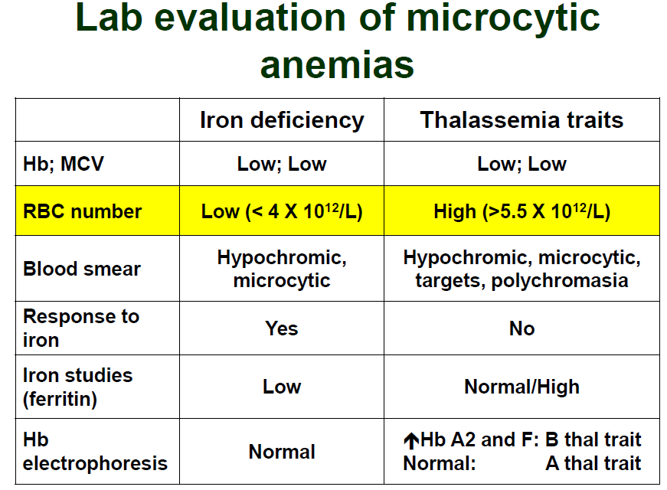

Slide 85

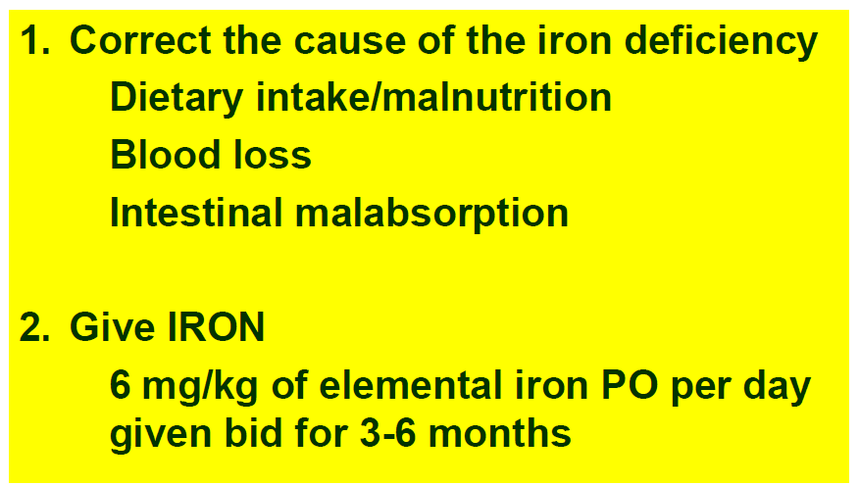

Slide 86

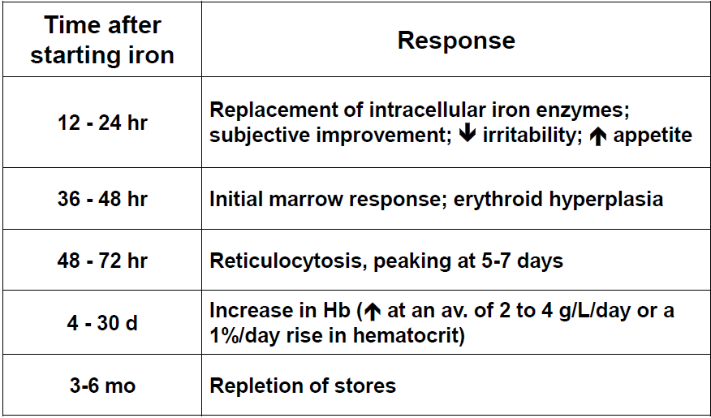

Slide 87

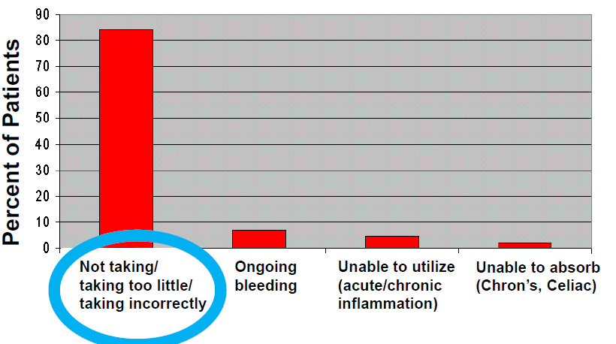

Slide 88
strategies to reduce Iron deficiency anaemia
Supplementation of Iron Folic Acid.
Food based approach
Dietary diversification and modification
Fortification of processed or staple food - home food fortification.
Control of helminthiasis (specifically hookworm), schistosomiasis and malaria

Slide 89
strategies to reduce Iron deficiency anaemia
Treatment of anaemia
Optimising maternal nutrition before and during pregnancy
preventing low birth weight and pre-term births; delayed cord clamping
control of parasites, and improvements in access to healthcare, infant feeding, food security
amelioration in socioeconomic status.

Slide 90
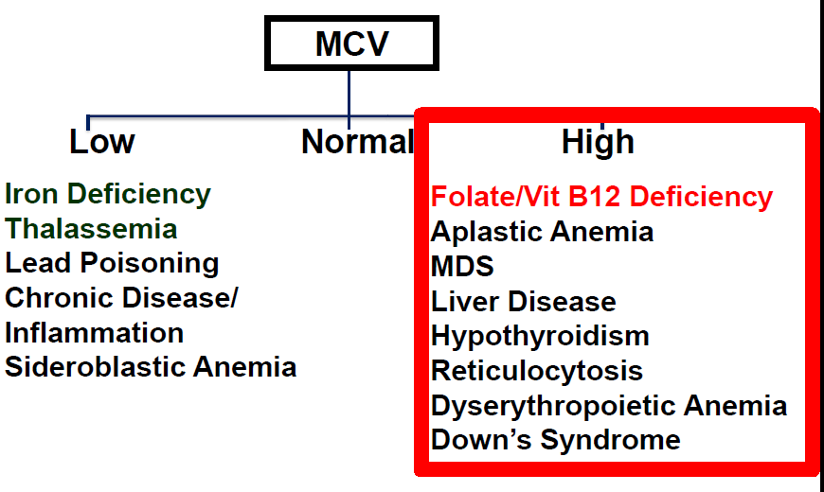

Slide 91
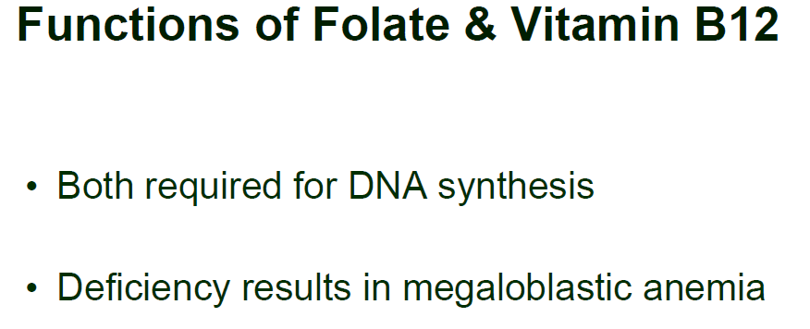

Slide 92
Megaloblastic Anemia
Megaloblastic changes –slowing of the nuclear division cycle relative to the cytoplasmic maturation cycle (ie, nuclear-cytoplasmic dyssynchrony).
hypersegmented neutrophils often precede macrocytosis, and macrocytosis often precedes anemia.

Slide 93


Slide 94



Slide 95
CBC and blood smear
MCV above 110 to 115 fL is associated almost exclusively with megaloblastic anemias.
Hypersegmented neutrophils
>5 percent of neutrophils with ≥5 lobes or ≥1 percent of neutrophils with ≥6 lobes

Slide 96


Slide 97


Slide 98



Slide 99




Slide 100




Slide 101
Typical response
● Hemolysis markers – Day 1 to 2
● Reticulocytosis – Day 3 to 4
● Anemia – Week 1 to 2 (initial improvement) and week 4 to 8 (normalization)
● Hypersegmented neutrophils – Day 10 to 14
● Leukopenia and/or thrombocytopenia – Week 2 to 4
● Neuropsychiatric improvement – starting within approximately three months and continuing to improve for as long as one year).

Slide 102
THANK YOU

